Slide 1
RENASASENSE – SmartCity
Standalone open sensor network

Slide 2
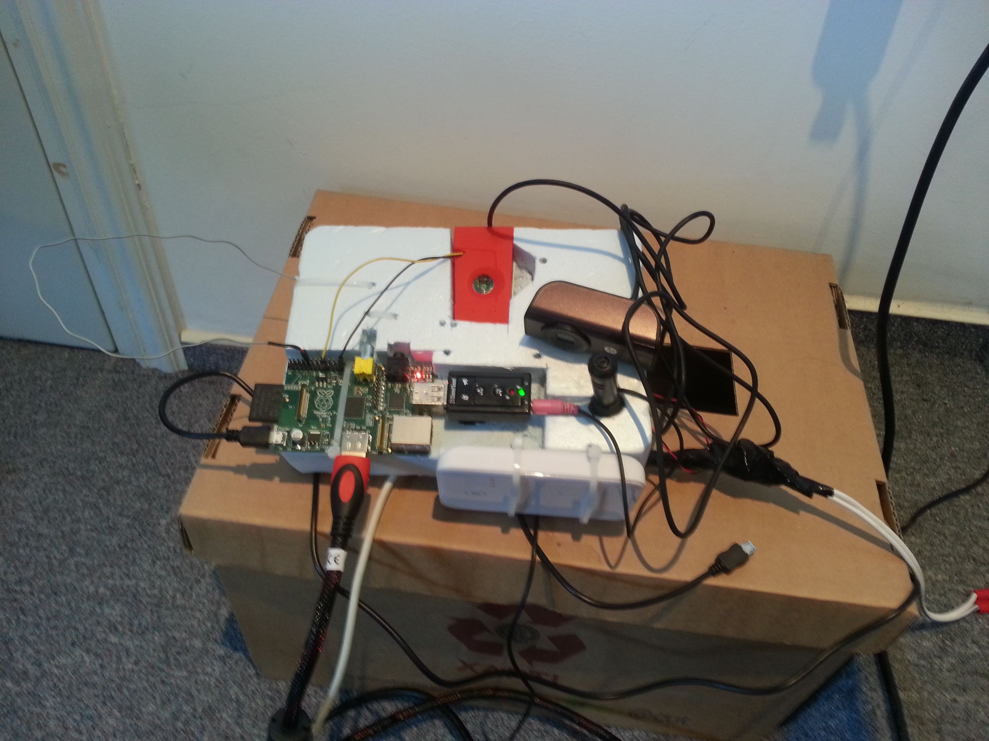
Goal
The purpose is an ambitious fully standalone multi-sensor device and a complete framework to upload and retrieve sensor data from anywhere in the world. Also open source examples will be created for both PC and Android OS and some 3D designs ready to be printed.

Slide 3
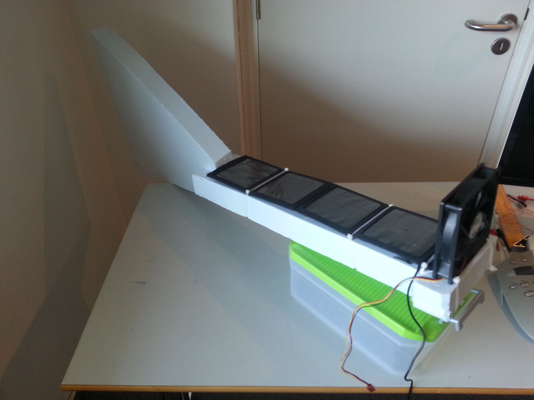
Components
The sensors we planned to use are the Texas Instruments bluetooth SmartTag (temperature, pressure, humidity, etc), microphone for sound level, HD webcamera for pictures of the environment,

Slide 4

Components

Slide 5
Other sensors:
ADC based "wind speed" sensor made from a computer fan, gps location. The brain of collecting data is a Raspberry Pi that is powered by solar energy with a backup battery, sending data via 2G/3G network using USB modem.

Slide 6
Outside design

Slide 7
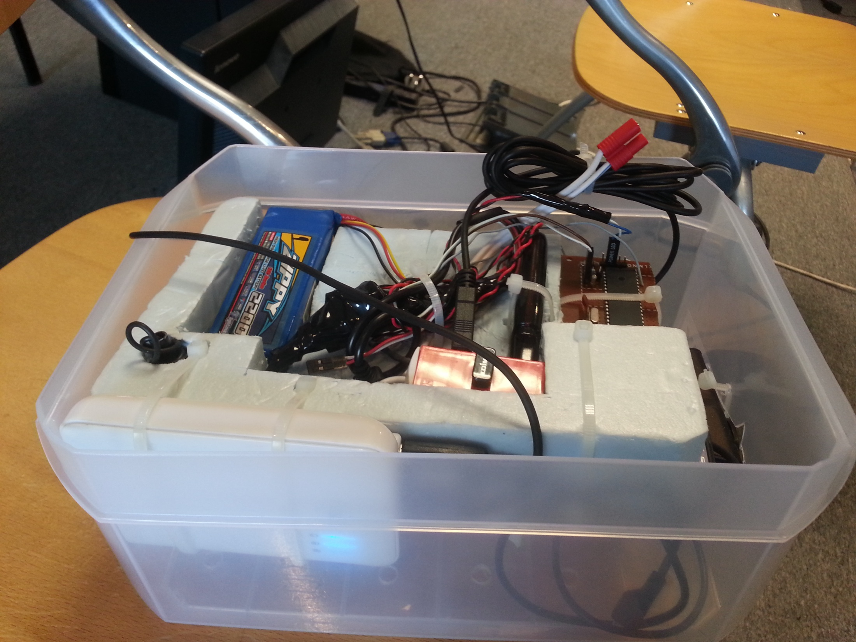

Slide 8
Standalone – solar powered
The whole sensor can be fitted inside a water proof box purchased in any store, with holes under it for temp/pressure/humidity and solar pannels on top of it. Basically it is a install and forget about it sensor, especially in Cyprus where there is a lot of sun.

Slide 10
GitHub – framework, working demos
Framework is developed on GitHub and will contain various programs to get sensor data, to upload data, server application to save data in database that is running now on a public ip, windows client for data visualization and android client.

Slide 11
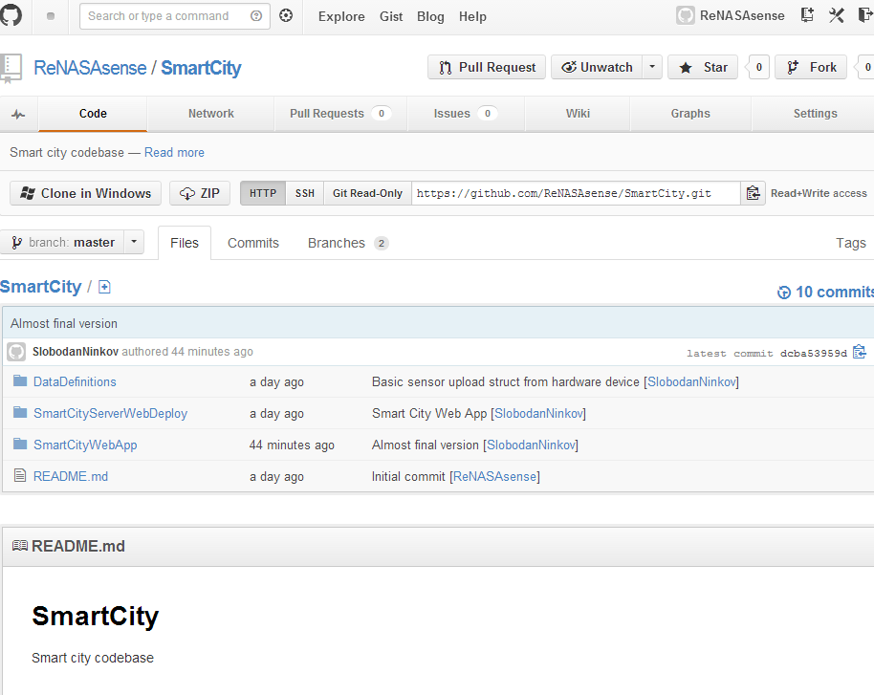

Slide 12
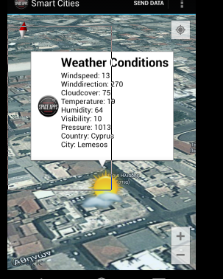
Android app

Slide 13
Mecanical Design
Since we don’t have a printer we created a proof of concept using of the shelf components and also designed some parts so anyone can build them

Slide 14
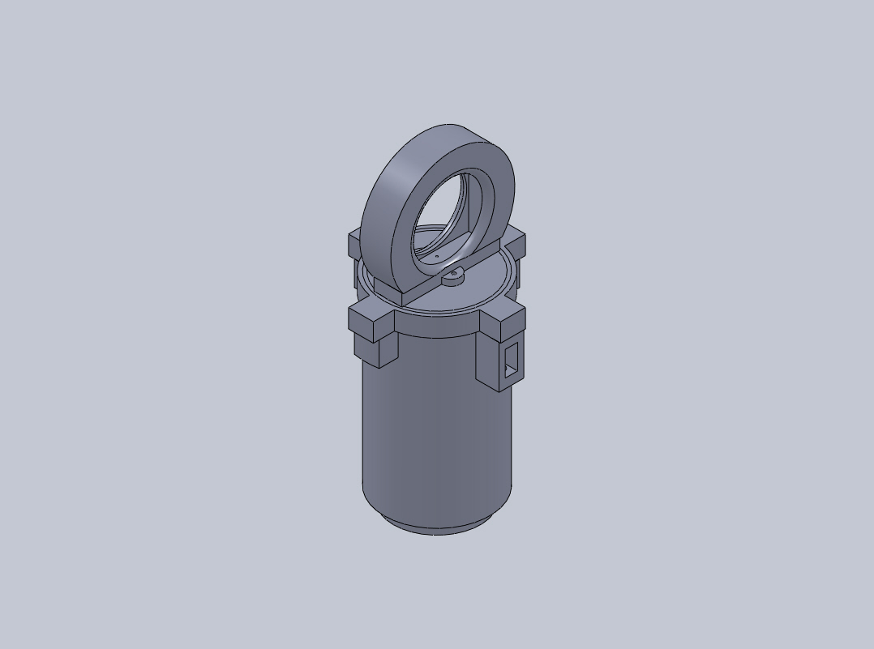
Mechanical

Slide 15
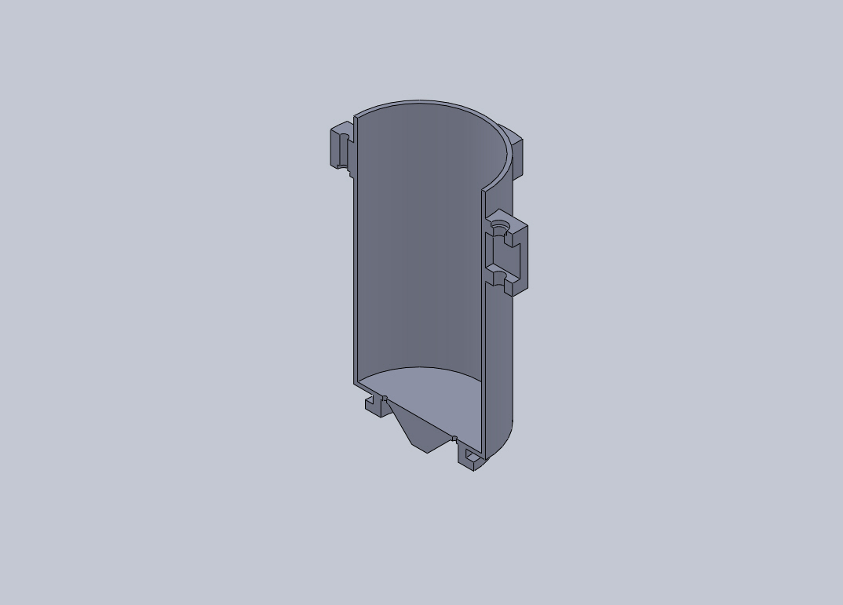

Slide 16
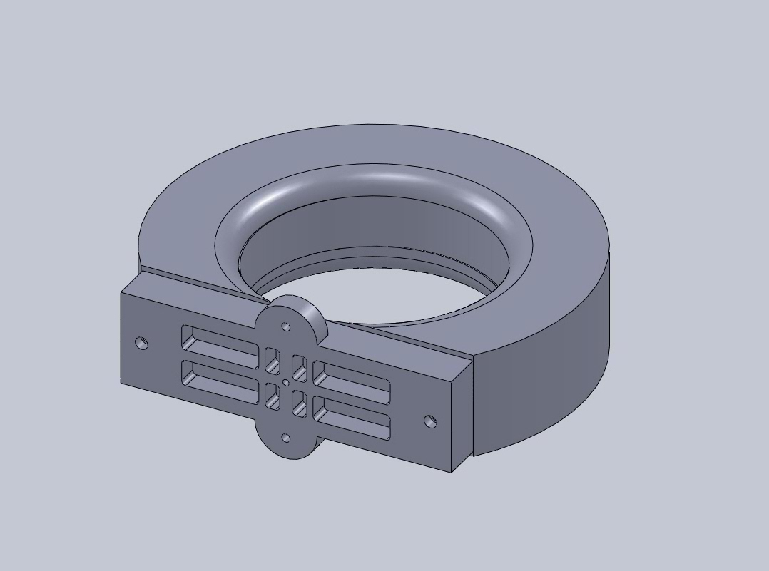

Slide 17
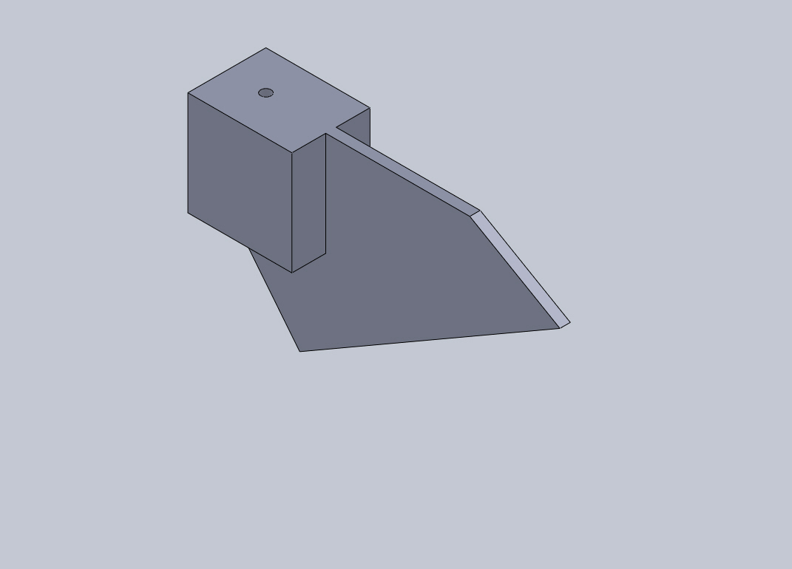

Slide 18
Popularizing sensor with Jewelery
Also another work in progress is to design and use a TI sensorTag as a jewelery that will be always connected to the user BLE smartphone and warn the user then certain thresholds are reached (like temperature over 35 degrees Celsius , high humidity using local sensors or solar radiation, tornado approaching in his area using Internet and gps sensor).

Slide 19
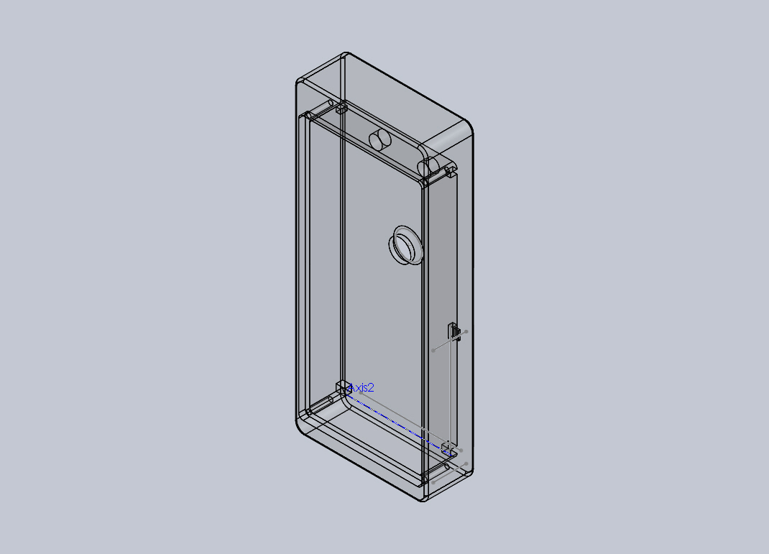

Slide 20
